Slide 1
CERTIFICATION REQUIREMENTS & PRESENTATION SCENARIOS
© KONICA MINOLTA
Notes:
Joe
3/8/19

Slide 2
KM Certification Final Presentation
Choose one of the 6 following scenarios (3 core tech-related and 3 MIT-related) and create a brief presentation wherein you will address the findings from your discovery and review the proposed solutions.
Please role play and present to us as if we are the customer.
Use the Solutions: 360 View slide from this deck to provide an overview of KM’s healthcare value proposition at the outset in order to better define the Konica Minolta healthcare value proposition, and how we’re different from our competitors.
Feel free to use this deck as a template for your presentation.
Record yourself using Teams, and send to the following:
      jcisna@kmbs.konicaminolta.us
      DMorrison@kmbs.konicaminolta.us
      mcardwell@kmbs.konicaminolta.us

Slide 3
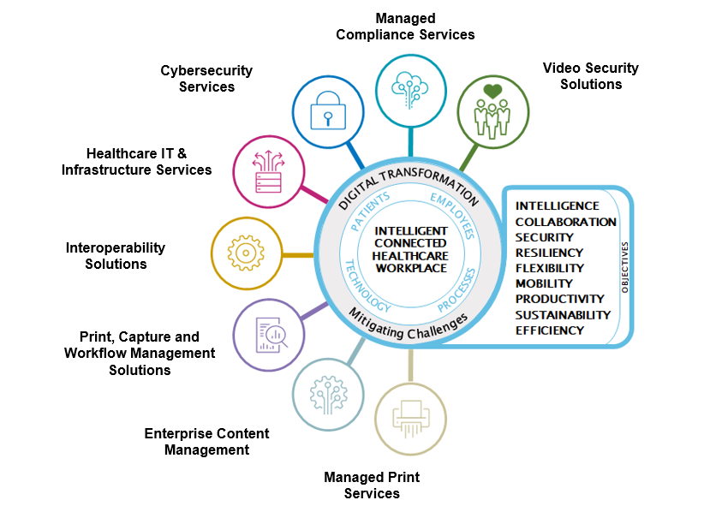
Healthcare Portfolio – 360 Degree View
Cybersecurity & Compliance Services
Layered Security Solutions
Video Security Solutions
Healthcare IT, Helpdesk, Cloud
Healthcare-Enabled MFP
Healthcare-Enabled MFP
Print, Capture & Workflow Solutions
Intelligent Information Services
Managed Print
Services

Slide 4
Acute Care Scenario
Scenario One - 200 Bed Hospital (net New Customer)
Your discovery session yielded the following information, challenges & initiatives:
Using Epic EHR
The hospital has a large fleet of MFPs with no security settings enabled. All print is sent direct to mapped printers, and there is nothing preventing anyone from walking up to the devices and retrieving documents with no way to track who printed what, and who retrieved documents, etc. Further, they are looking for ways to reduce operational expenses.
Using an older fax server that is not performing, but also still using many analog fax machines.

Slide 5
Ambulatory Care Scenario
Scenario 2 - 15 Physician Multi-Specialty Clinic (Existing Customer)
Your discovery session yielded the following information, challenges & initiatives:
Using Aprima EHR
Currently all clinical/patient documents requiring scanning are done in a central scanning area in the records storage room using Fujitsu scanners, and scanning to a folder, wherein a staff member then accesses the scanned images and indexes them to the appropriate record in the Aprima system. They use the document management workflow available in Aprima. It appears that the steps necessary to attach a scanned document to a patient record required several steps.

Slide 6
Extended Care Scenario
Scenario 3 – 100 bed Skilled Nursing Facility (SNF) (Net New Customer)
Your discovery session yielded the following information, challenges & initiatives:
Using PointClickCare (PCC) EHR
Nearing the end of lease with Ricoh for MFPs.
Most patient referrals come from 8 local hospitals and health systems, with 5 of them accounting for about 75% of their overall referral volume.
A couple of the hospitals require that they access all patient referral documents from a community portal, requiring separate log ins, but the overwhelming majority of the inbound referrals are via fax.
Currently they use stand alone scanners and scan patient-centric documents to a network folder. Next a staff member must select the documents from the folder manually and then index into PCC, and there has been instances where documents are attached to the wrong patient record.

Slide 7
Extended Care Scenario - MIT
MIT Scenario 1 – Extended Care For over 40 years, Customer A ( CA) has provided healthcare services for the Aging population, housing and behavioral health services. CA was established in 1959 as a private, not-for-profit, community-based organization designed to meet the human services needs of the residents of Springfield, Illinois.
They are in need of a Managed Service Provider to update and maintain their IT infrastructure, support end-users, and provide strategic guidance. CA has 3 locations in the greater Springfield area. One is an extended care facility with a combination of 50 assisted living resident apartments and 25 skilled nursing beds. The second location provides outpatient healthcare and behavioral services. There are 5 providers supported by 30 other staff members here. The 3rd location is currently an admin office with 15 end users that is planned to expand into a patient care facility sometime in 2024. Both of the latter 2 locations are open M- F from 7am – 6pm. The extended care facility is open 24/7/365.
CA’s on prem servers are at their admin location. Moving to the cloud is a possible option, though not the top priority.
CAs current service provider can no longer keep up with their IT needs and is unable to support their expansion and future cloud migration.

Slide 8
Acute Care Scenario - MIT
MIT Scenario 2 - Acute Care For the past 80 years, XYZ Hospital has been a trusted name in the community, striving for excellence and delivering professional and compassionate care. XYZ Hospital is a 62-bed acute care hospital located in Snow Hill, Maryland.
XYZ Hospital is currently seeking to have a Healthcare IT and Compliance assessment performed for their healthcare systems. XYZ Hospital needs assistance identifying gaps and risks associated with their current state to improve delivery and supportability of their Healthcare IT systems.
They are looking for an assessment of XYZ Hospital’s healthcare applications, security, disaster recovery and backup capabilities, and annual HIPAA risk assessment.

Slide 9
Ambulatory Care Scenario - MIT
MIT Scenario 3 - Ambulatory Care Best Care Inc is a multi-specialty, multi location healthcare organization located across the Eastern Shores of Maryland and Delaware using KM MFPs. They we notified yesterday by their credit card vendor, FlexCard, that their data has been breached. The vendor claims to be notifying all proper authorities and entities.
Best Care would like a full vulnerability and security risk assessment competed along with urgent guidance regarding this data breach.
They approached their current MSP who replied that they are not familiar with all aspects of this request and cannot accommodate the immediacy of breach protocol time lines.

Slide 10

Thank You!

